Slide 1
Introduction to Systems Analysis and Design
MIS 372 Spring 2022

Slide 2
Learning Objectives
1. More on IT & Software
2. Modeling Business Operations
3. Systems Development Life Cycle
4. Systems Analysts

Slide 3


1. More on IT & Software
Does IT still matter?

Slide 4
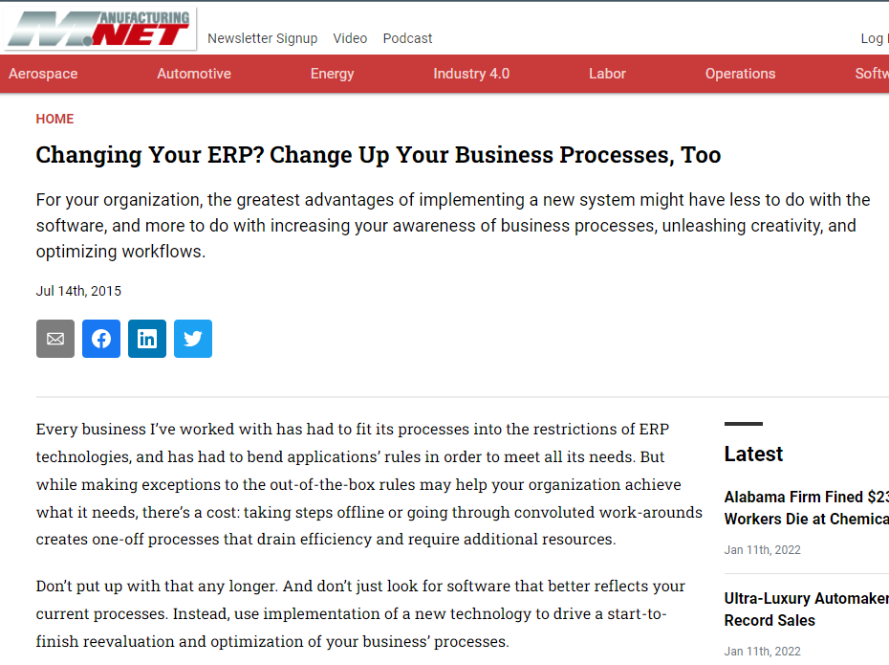
More on IT & Software (cont.)
Why software products are important?
It changes workflow!

Slide 5
Classification of IS
Decision
Structures
Operational IS
Management IS
Strategic IS
Unstructured
Semi-Structured
Structured
Short-term
Medium
Long-term
Time Frame of Influence

Slide 6
Classification of IS (cont.)
IS Type | Examples | Primary Function
Strategic IS | Knowledge management, Dashboard system, Forecasting systems | Exploring Possibilities (Decision Support)
Management IS | Enterprise Resource Management (ERP), Inventory Control System, Production Control System, | Streamlining Processes (Process Support)
Operational IS | User Productivity Suite, Transaction Process Systems (TPS), Digital Assistants, etc. | Efficiency-seeking (Task Support)

Slide 7
2. Modeling Business Operations
System analysts use modeling to represent company operations and information needs.
Modeling produces a graphical representation of a concept or process that systems developers can analyze, test, and modify.
A system analyst can describe and simplify an information system by using a set of business, data, object, network, and process models.

Slide 8
Modeling Business Operations (cont.)
Business Process Modeling
Business Profile
A Set of Other Models
Overview of a company’s mission, functions, organization, products, services, customers, suppliers, competitors, constraints, and future direction.
Models (or diagrams) that describe the information that a system must provide. For example, data, objects, networks, and other components.
Model-based systems engineering (MBSE) is one of the leading methods used by systems analysts to develop information systems.

Slide 9
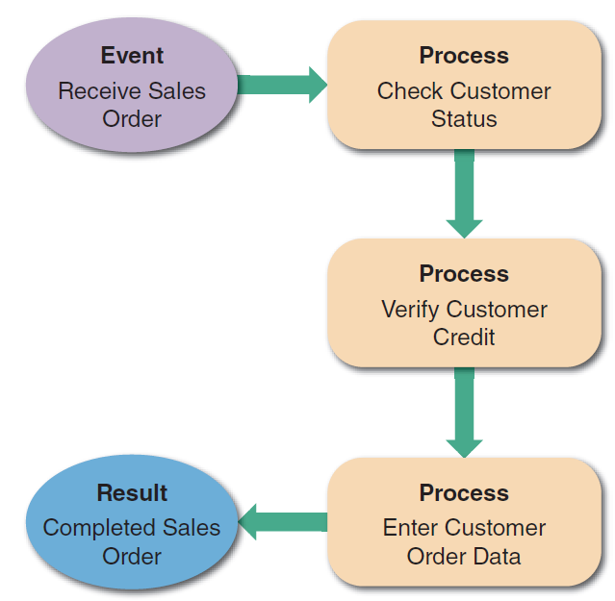
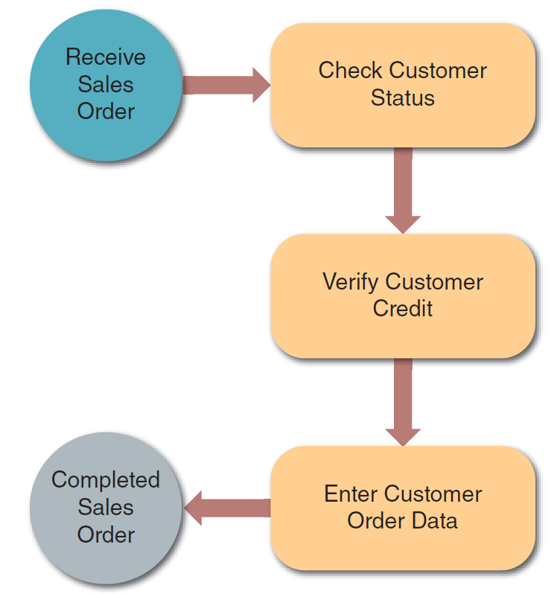
Business Process Modeling Notation (BPMN)
Business process modeling notation (BPMN) includes standard shapes and symbols to represent events, processes, workflows, and more.
A simple business model might consist of an event, three processes, and a result.
This sample uses BPMN to represent the same events, processes, and workflow shown in the left.

Slide 10
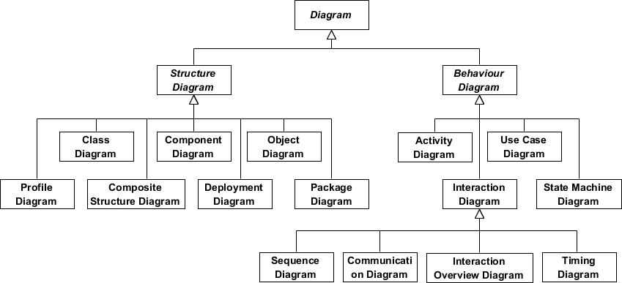
Object-Oriented Modeling in UML 2.5

Slide 11





Popular Diagram Tools

Slide 12
3. Systems Development Process
3 Different Approaches
Waterfall
Development
Object-Oriented Development
Agile Development

Slide 13
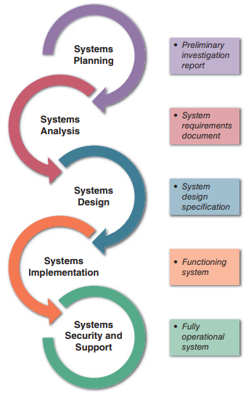
Waterfall Development (structured analysis)
Represents the system in terms of data and the processes that act upon that data.
System development is organized into phases, with deliverables and milestones to measure progress.
Modeling tools: Data flow diagrams (DFDs) and process descriptions.

Slide 14
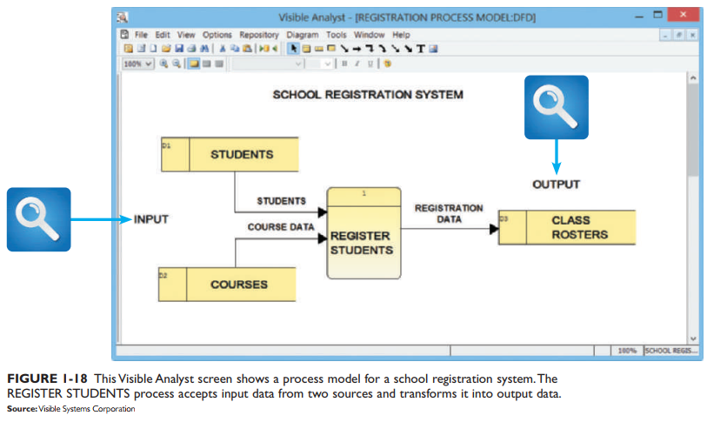
Data Flow Diagram

Slide 15
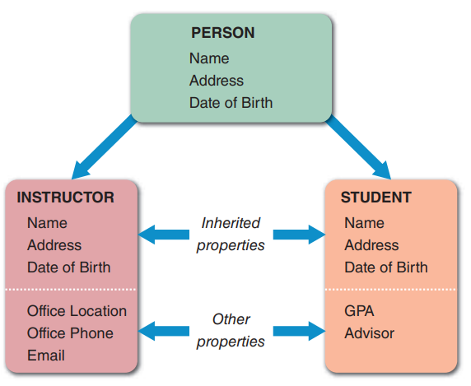
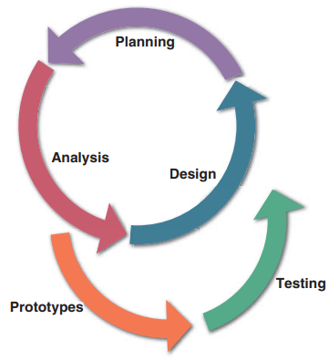
Object-Oriented Analysis
Views the system in terms of objects that combine data and processes.
The objects represent actual people, things, transactions, and events.
Compared to structural analysis, O-O phases tend to be more interactive. Can use the waterfall model or a model that stresses greater iteration.

Slide 16
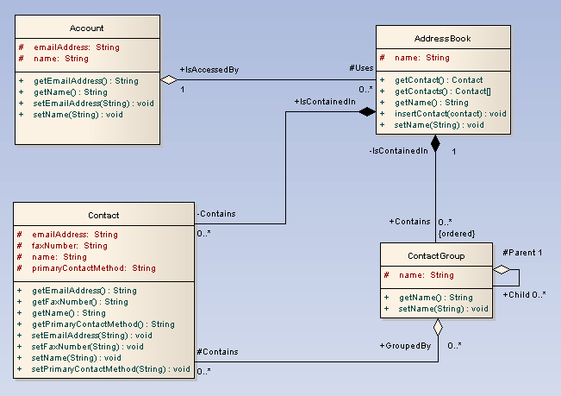
Class Diagram in UML

Slide 17
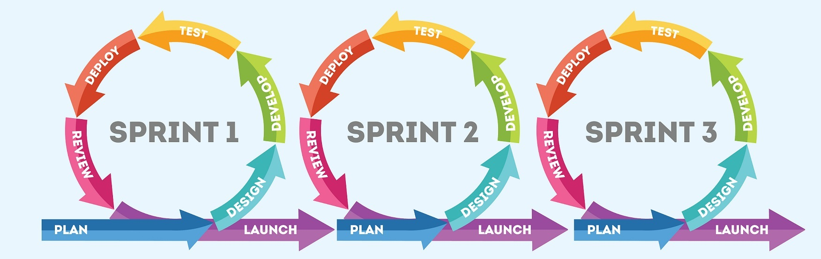
Agile Development
Stresses intense team-based effort.
Breaks development into iterations, that add functionality.
Each cycle is designed, built, and tested in an ongoing process. Attempts to reduce major risks by incremental steps in short time intervals.
Modeling Tools: tools that enhance communication, such as collaborative software, brainstorming, and whiteboards. Business process modeling work well with agile methods.

Slide 18
4. Systems Analysts
They investigates, analyzes, designs, develops, installs, evaluates, and maintains a company’s information systems
Constantly interacts with users and managers within and outside the organization

Slide 19
Job Descriptions for a Systems Analyst
Training users on how to appropriately utilize their computer systems
Writing instruction manuals for systems
Consulting with managers to determine what role the systems play in the business
Testing the systems on a regular basis to ensure quality and function
Preparing costs and benefits analysis on systems
Brainstorming new ways to add more functionality to systems
Choosing and configuring the hardware and software of a system
From: https://www.indeed.com/hire/job-description/systems-analyst

Slide 20
Job Descriptions for a Business Analyst
Gather and analyze data for potential business expansion
Identify specific business opportunities
Influence stakeholders to support business projects
Assist with project management for selected projects
Coordinate with different departmental teams to produce better business outcomes
Test business processes and recommend improvements
From: https://www.indeed.com/hire/job-description/business-analyst

Slide 21
Job Classification based on Focus Areas
Technical Orientation
Software Engineer
Systems
Analyst
End
User
Business Analyst
Process Orientation

Slide 22
Systems Analyst - Knowledge, skills, and education
Technical knowledge
Communication and business skills
Critical thinking skills
Education: college degree in information systems, science, or business
Some IT experience is required

Slide 23
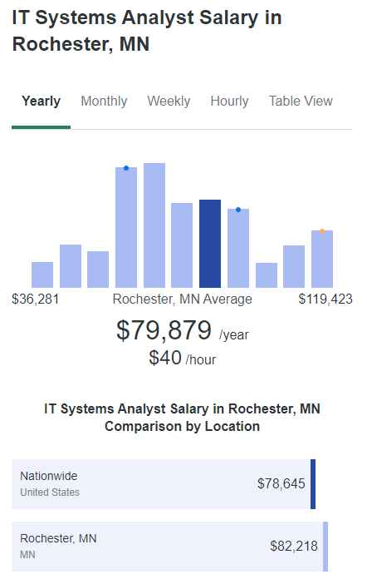
Systems Analyst Salary and Job Outlook
According to the U.S. Bureau of Labor Statistics (BLS), the median annual wage for systems analysts was $90,920 in May 2019.
From 2014 to 2024, the BLS projects an increase of 14 percent for systems analysts, which is higher than average, with 191,600 net new jobs expected during that 10-year period.

